Slide 1

Town of Lunenburg
FY2024 Tax Classification Presentation
March 12, 2024

Slide 2
What Is The Purpose Of This Presentation?
Select a single or split tax rate
Whether to adopt an open space discount
Whether to adopt a residential exemption
Whether to adopt a small commercial exemption
Notes:
At tonight’s classification hearing, I will be asking the Council to vote whether or not to select a single or split tax rate, whether or not to adopt an open space discount, residential exemption and a small commercial exemption to determine a residential factor which will determine the percentage share of the tax burden allocated to each class of property. Communities with Open Space Discounts: Barnstable, Boston, Brookline, Cambridge, Chelsea, Everett, Malden, Nantucket, Provincetown, Somerset, Somerville, Tisbury, Waltham.

Slide 3
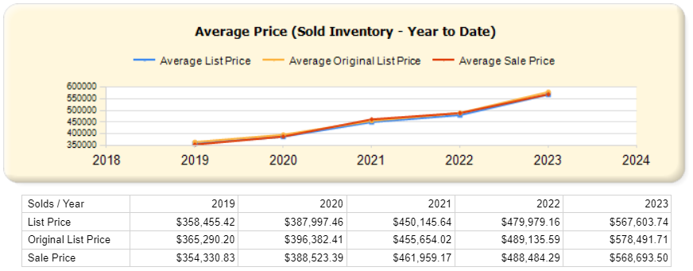
Values Continue to Rise In Lunenburg Single Family Sales Past 5 Years
Data courtesy of Pinergy MLS
Notes:
For FY24 we’re looking at sales that occurred in calendar 2022, Sale prices continue to climb for calendar year 2023. In FY25 we will be looking at 2023 sales. As you can see from above, the sale prices are not increasing as much

Slide 4
Full and Fair Cash Value Overall Changes From Last Year
Class | FY2023 | FY2024 | % Change
Residential | $1,957,462,820 | $2,057,467,522 | 5%
Comm/Ind/PP | $153,972,120 | $185,259,058 | 20%
% of Total | 92.7%/7.3% | 91.7%/8.3% | -1%/+1%
Total Value | $2,111,434,940 | $2,242,686,580 | 6.2%
Notes:
This slide compares the full and fair cash value for FY23 & FY24. The change to the residential class is 8.6% and the change to the commercial class is 4.6%

Slide 5
Value Changes Overall By Use
Single Family Waterfront: +10-14%
Single Family Non-Waterfront: +6%
Condos: +30%
Multi Family: up to +30%
Commercial/Industrial: +6-8%
Personal Property +17%

Slide 6
What Is Causing The Market to Increase What Happened In 2022?
Record low mortgage interest
30-year fixed rates were in the mid 3’s, significantly increasing buying power. By the end of calendar year 2022, rates more than doubled to 7%
Despite high interest rates, there is still high demand
High interest rates contributing to low inventory- nobody wants to move and give up their low interest rates.
As seen on slide 4, sale prices continued to rise in 2023, which will affect FY2025 assessments

Slide 7
Single Family FY23 VS. FY24
Res Rate FY23 | FY23 Avg Value | FY23 Avg Bill
$14.62* | $470,178 | $6,874
Res Rate FY24 | Y24 Avg Value, | FY24 Avg Bill
$14.10 | $481,417 | $6,788
Notes:
Here we have a comparison of the SF rate, average value and average tax bill for FY23 vs FY24. The average value for FY23 was $481,271. The average value for FY24 is $518,172.

Slide 8
CIP FY23 VS. FY24
CIP Rate FY23 | FY23 Avg Value | FY23 Avg Bill
$14.62 | $379,242 | $5,545
CIP Rate FY24 | FY24 Avg Value | 2024 Avg Bill
$14.10 | $473,808 | $6,922
Notes:
This is a comparison of the CIP rate, value and average bill for FY23 vs FY24. The average CIP value for FY23 was $779,126. The average value in FY24 is $826,729.

Slide 9
Fiscal Year 2024 Levy Limit
FY 2023 Levy Limit | $28,043,723
Plus 2.5% | $701,093
Plus New Growth | $630,220
FY 2024 Levy Limit | $29,375,036
Debt Exclusion | $2,477,704
FY 2024 Maximum Allowable Levy | $31,852,740
Notes:
The FY23 levy limit was $71,343,668 , you add the 2.5% plus the new growth resulting in a FY24 levy limit of $73,585,400. This year there is a debt exclusion of $334,518 it brings the FY24 maximum allowable levy to $73,919,918. Actual value of growth is higher but the numbers are lower because it’s more heavily residential growth

Slide 10
Comparison of Surrounding Communities (Fiscal Year 2024)
Community | FY23 Residential | Commercial | Shift | Average Single-Family Value | Average Single Fam Bill
Lunenburg | $14.10 | $14.10 | No Shift | $481,417 | $6,788
Leominster | $14.51 | $14.51 | No Shift | $414,478 | $6,437
Ashby | $15.53 | $15.53 | No Shift | $380,947 | $5,916
Townsend | $14.41 | $14.41 | No Shift | $423,144 | $6,098
Shirley | $13.57 | $13.57 | No Shift | $446,590 | $6,060
Fitchburg | $14.81 | $14.81 | No Shift | $328,995 | $4,872
Groton | $15.09 | $15.09 | No Shift | $694,934 | $10,487

Slide 11
Residential Exemption/Tax Shift/ Small Commercial Exemption
Residential Exemption- Historically, Lunenburg does not elect to adopt a residential exemption, as most residential properties are owner occupied and it would be of minimal (or any) benefit to taxpayers
Tax Shift- Being predominantly residential, Lunenburg historically does not elect to adopt a shift in the tax rate. A shift would reduce the residential tax rate and increase the commercial rate. This would significantly increase the amount property tax businesses pay and would likely thwart growth in that class.

Slide 12
Residential Exemption/Tax Shift/ Small Commercial Exemption
Small Commercial Exemption- Adopting the small commercial exemption allows the town to exempt up to 10% of the property valuation for owner-occupied businesses with 10 or less employees and a valuation of less than $1,000,000. Lunenburg historically has not adopted this exemption
Open Space- Adopting an open space discount reduces the tax rate on privately owned land that contributes to the benefit and enjoyment of the public. Lunenburg has not adopted this in the past.

Slide 13
Action
Town Council is choosing a shift
Yes_____ No_____
2. Was a discount granted to Open Space?
Yes________ No_______
3. Was the Residential Exemption Adopted?
Yes________ No_______
4. Was a Small Commercial Exemption adopted?
Yes______ No_______

Slide 14
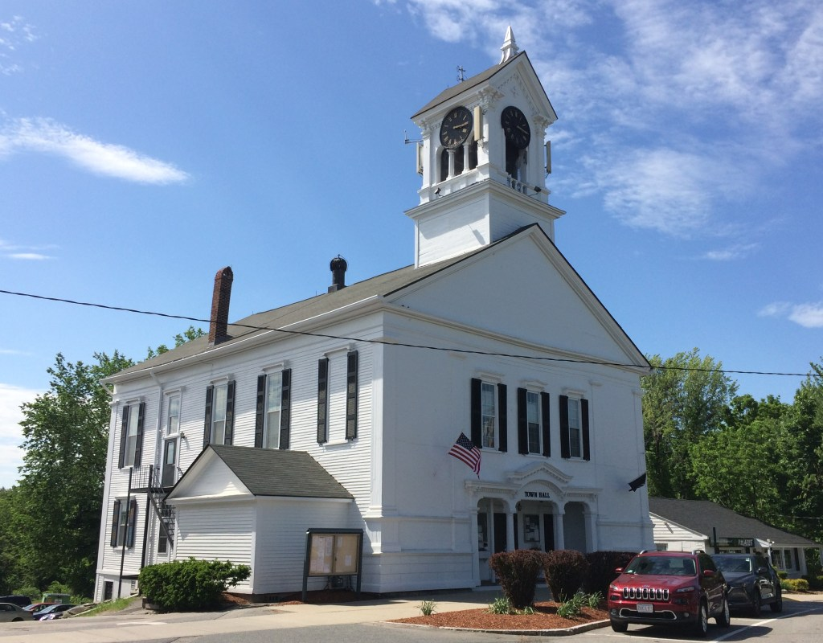
Thank You!
Lunenburg Board of Assessors
978-582-4145

