Slide 1


Water Resource Technologies
Florida
Water Resource Technologies
The Low Pressure Sewer Experts
Connecticut & Massachusetts
Protecting our Groundwater

Slide 2

Vision and Mission
Who are we?
Water Resource Technologies Vision
A Midsize growing company, our entire focus is on customer support. Quality service is paramount and is the basis on which we build long-term relationships. At Water Resource Technologies, ownership is held by working members of the firm and individuals have a personal stake in job quality and performance.
Water Resource Technologies Mission
To be a premier company known for its operational excellence, management talent, and market leadership.
Our Promise
We promise to exceed your expectations, incorporate the latest technologies, and build our relationship on trust, service and product performance.
Translating Vision to a Clear Strategy:
Protecting the Worlds’ most precious resource - Water

Slide 3
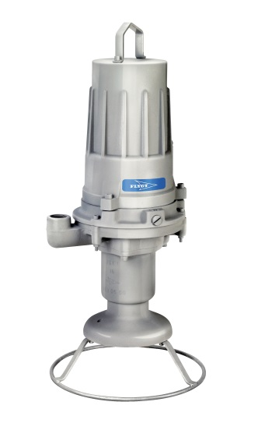

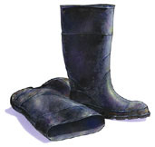
What do we do?
Core competencies
System design
Product sale
Service
Application Engineering
Hydraulic Analysis
Cost estimating
World-leader in Low Pressure Sewer Design & hydraulic modeling
Submersible wastewater pumps
Pipes, Valves and fittings
Flushing stations
Air Release stations
“High Tide” satellite telemetry
Wager Vents
Start-up assistance
24/7 service
Installation and operation training
Repair training
Electro-fusion & Butt-fusion welding
Application Engineering
Hydraulic Analysis
Cost estimating
World-leader in Low Pressure Sewer Design & hydraulic modeling
Submersible wastewater pumps
Pipes, Valves and fittings
Flushing stations
Air Release stations
“Wager Vents
Start-up assistance
24/7 service
Installation and operation training
Repair training
Electro-fusion & Butt-fusion welding

Slide 4
Why is that important?
Knowledge
Focus
Trust
Our Company is focused on one thing…
You the customer!
Meeting your needs
Surpassing your expectations for service and responsiveness
Earning your trust

Slide 5
Where are we?
2003 Water Resource Technologies Founded
  Offices open in NY & NJ
  Within a few short years, WRT was one of the Top 3 E/One distributors in the country
2005 Connecticut office opens
2006 Florida operations established (3 offices in the state)
2011 Georgia operations begin
2015 MA, NY, NJ, & CT territories begin representing Flygt pressure sewer products and upgrading existing E/One systems to Flygt.

Slide 6
Is product design important?
Just like other appliances in your home, there are major differences in the design of grinder pumps!
Three important things to consider.
Seal location and its vulnerability
Controls of the pump under water
Bearings & shaft stability = Motor life

Slide 7
Other manufacturers:
Seal is exposed to and
lubricated by sewage!
Items in the sewage such as dental floss can get caught in the seal causing it to fail and flood the electric motor.

Slide 8
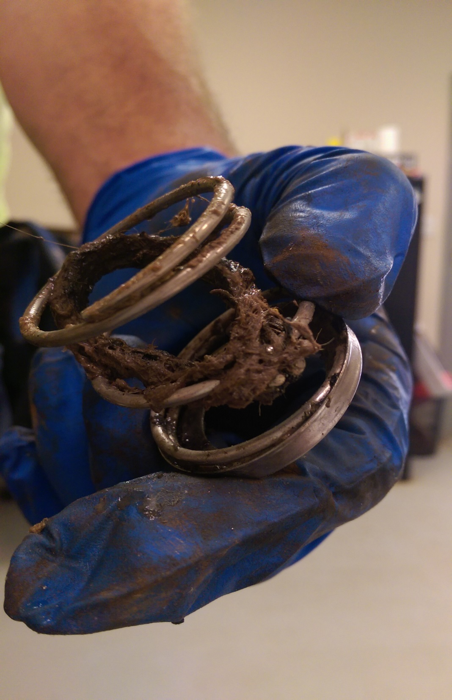
What does this mean?
Clump of hair wrapped
Around seal spring and
Caused a catastrophic
Pump failure.
*3 month old pump, non-
Warranty failure

Slide 9
Flygt PC Pump has the double Grip-lock seal lubricated by vegetable oil.
Flygt pump:
Seal is never exposed to sewage

Slide 10
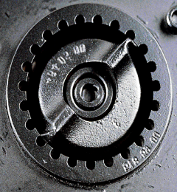
Robust grinder wheel and shredder ring
Cutter wheel is 316 Stainless
Steel hardened throughout
Shredder Ring is chrome alloyed
Cast Iron, Class 30B
Able to grind virtually anything!
Wipes
Sanitary napkins
Tee Shirts
Shop rags

Slide 11
Other manufacturers:
Controls are inside the pump
Inside means the pump must be removed in order to fix it.
If the station is flooded it will need to be pumped down in order to get to the parts. More time, potential more cost.

Slide 12
Flygt pump:
Controls located in the panel, not in the pump!

Slide 13
White Paper
Henry S. Albro, F. R. Mahoney & Associates
“Marion has a large percentage of seasonal homes. Seasonal dormancy may contribute to service issues of corrosion or moisture in controls when power is turned off for 3 months of the year. Residents are instructed on the proper winterization procedure to minimize these issues.”
Ownership of Pressure Sewer Systems “The only thing we have to fear, is fear itself” Henry S. Albro, F. R. Mahoney & Associates NEWEA January 29, 2014.

Slide 14
Sturbridge MA Annual Report 2014
117 E-One pumps replaced.
103 E-One pumps rebuilt.
They have 800 pumps in town.
Over 25% of them needed replacing in 2014 Alone!

Slide 15

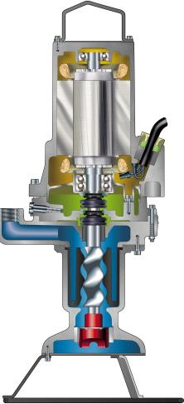


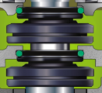
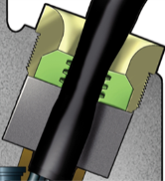
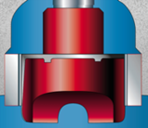

3068.175 Features
BEARINGS
Double row lower bearings
MOTOR
Trickle impregnated windings
Griploc™ SEALS
Tandem Mechanical
Seal system in oil bath
CABLE ENTRY
Strain relief protects the cable connection
CUTTING ASSEMBLY
Hard Iron™ cutter wheel &
Hardened SS cutting ring
SHAFT STABILITY
Bronze sleeve type bearing keeps shaft stationary
Notes:
Flygt reputation –Over 50 years of providing product, engineering and service solutions to the waste water market in the USA.
Simple Easy Access Control Panel –Separates the start/run capacitors from the pump eliminating the need to pull the pump to inspect/replace capacitors.
Added Protection –Only manufacturer to use a double row of lower bearings and two independent mechanical seals resulting in longer run time between service intervals.
Longer Motor Life –Method used to insulate windings eliminates air pockets allowing the motor to run at a lower temperature extending motor life.
Better Performance -Higher head capacity and more flow at run-out.

Slide 17
Multitrode Level sensing device
*10 year Warranty!
Flygt level sensing device.
Multitrode replaces floats and the need for quirky air switches.
No moving Parts! Uses conductive properties of water to operate pump and high water alarm.

Slide 19
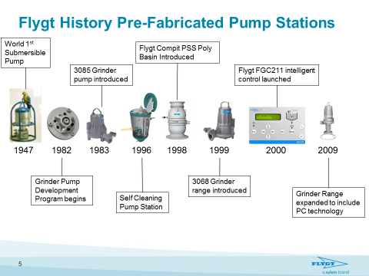

Slide 21
Ease of install for home owners!
No Concrete Ballast needed in high water areas. (saves money on install)
The station is Bright White! makes it easy to see what's going on inside.
Risers available for greater Depths

Slide 23
Compit Benefit's vs Other Guys
Holds more capacity (239 Gallons) in case of a power outage than the E-One station being offered for the same or less money. ( Better value)
Self cleaning, the station is designed to have debris flow toward the pump. This prevents potential build up conditions.
Easy for contractor to install no need to purchase longer power cords or pay for concrete trucks. Quick and easy connections.
You can cover the lid with mulch or anything else you want. This will not void your warranty! Unlike E-One stations.

Slide 24
WRT Simplex Value Station
Same pump same control panel same level sensing device.
Smaller capacity and requires concrete ballast in high water areas. Less cost to home owner.
Basin also has self cleaning bottom.

Slide 25
WRT Simplex Value Station

Slide 26

Warranty Response Team
Warranty transferable to new owner.
Provide 24-hour ( emergency service )
Maintain an inventory of standard parts
Always carry spare pumps (no charge for loaners) if we can not fix it on site we will install a loaner for you to use.
No inconvenience to the home owner.
Guarantee all Service work (one year on parts & labor)
No discharge of raw water on home owner property

Slide 27
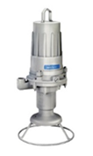

Water Resource Technologies
Pete Romprey
Territory Service and Sales Manager
Water Resource Technologies
promprey@wrtllc.com
860 480 5910 Direct Line

Slide 28
Water Resource Technologies
Florida
Water Resource Technologies
Protecting our Groundwater
Thank you !
Questions?

